Slide 1

Guess My breed
Koteswar Enamadni || Mamatha Thippani

Slide 2
Project Statement
The primary goal of this project is to use TensorFlow and Convolutional Neural Networks (CNN) to classify the breeds of dogs from unstructured image data.

Slide 3
Load
Load the labels and pictures of the dogs.
Convert
Convert the labels/pictures into Tensors using Tensor flow.
Apply
Apply CNN model to predict the names of the test images.
Train
Train the model using images.
Project Approach

Slide 4
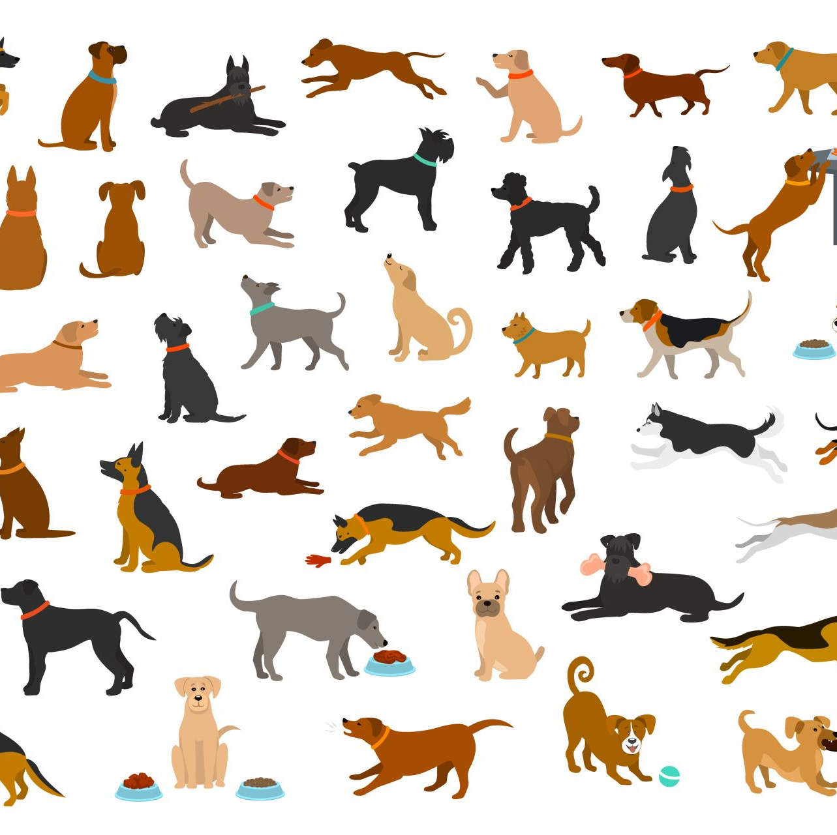
Evaluation methodology
The Convolutional Neural Networks (CNN) technique will be employed to train a model capable of predicting dog breeds.
The breed predictions will be evaluated based on the accuracy of the classifier, and these results will be graphically compared for a comprehensive analysis.

Slide 5
Data Set Description
TRAIN DATA & TEST DATA SETS:
Contains the dog images of different breeds.
LABEL DATA SET:
Contains different Dog breed names with respective ID.

Slide 6
Data Processing
Given a large dataset that is difficult to process on local servers, we opted to use Google Colab with its high GPU capability.
To prepare the data for training, we used TensorFlow and its libraries to convert the raw data into numerical representations called Tensors
For image data, we created a preprocessing function that takes an image filepath as input, uses TensorFlow to read the file and save it to a variable, then converts the image to Tensors. We also resized the image to a shape of (224, 224) to ensure consistency. The resulting function returns the modified image in Tensor format.

Slide 7
Model Building with Data Sets
The model used is a MobileNetV2 model trained on the ImageNet dataset, and it is designed for image classification. The model is pre-trained on a large dataset of images, and it is available for use in TensorFlow through the TensorFlow Hub platform.
we utilized Keras, which is a high-level API that operates on top of TensorFlow. Keras simplifies the implementation of intricate neural networks by providing an easy-to-use framework.
We employed Keras to divide our data into small batches containing different numbers of dog images, such as 32, 100, or 1000.
We then used these batches to train our model consecutively, enabling us to identify the breed of a dog.

Slide 8
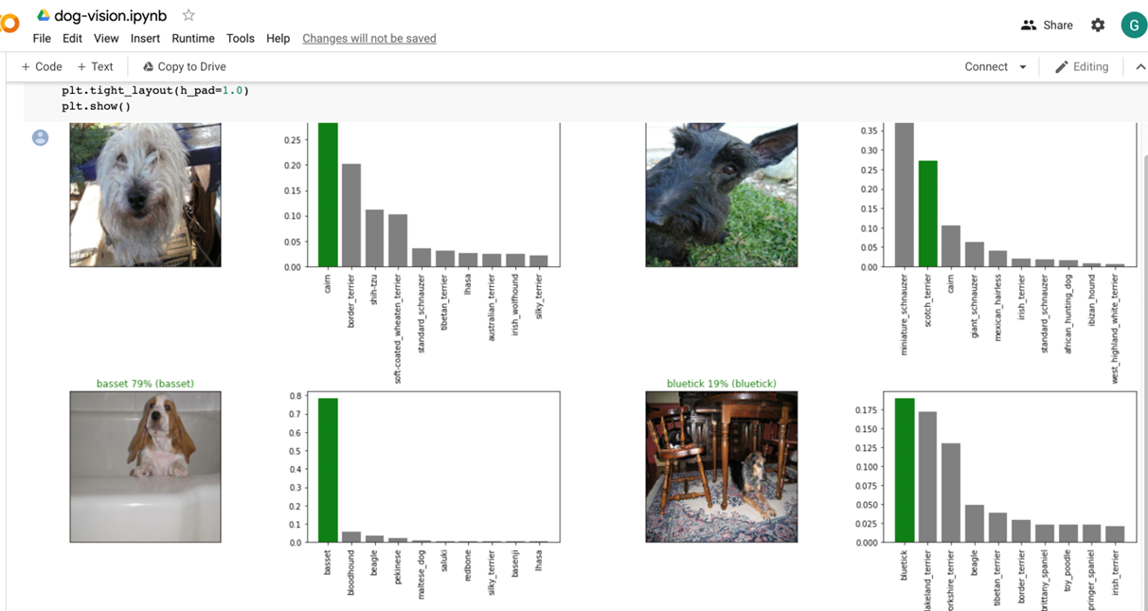
Observations after Building Model
The output of our model displays the probability of each dog breed prediction for the respective dog images that were loaded into the model.

Slide 9
Deliverables
A python code of a CNN model used to predict the names of dog breeds.
GitHub repository link for project code.
Code walkthrough video on YouTube.

Slide 10

Thank you Bhow Bhow

